Slide 1
Improving Clinical Trial Recruitment through FHIR and Natural Language Processing
Charity Hilton
Lead, Natural Language Processing
Center for Health Analytics and Informatics
Georgia Tech Research Institute

Slide 2
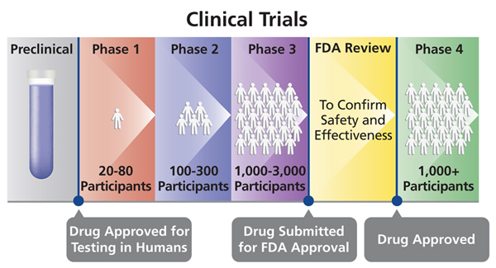
Clinical Trials

Slide 3
Clinical Trials are Expensive
Average costs of phase 3 clinical trials range from $11.5M-$52.9M.
Currently 49,396 clinical studies recruiting on clinicaltrials.gov.
The major cost is finding and enrolling patients.

Slide 4
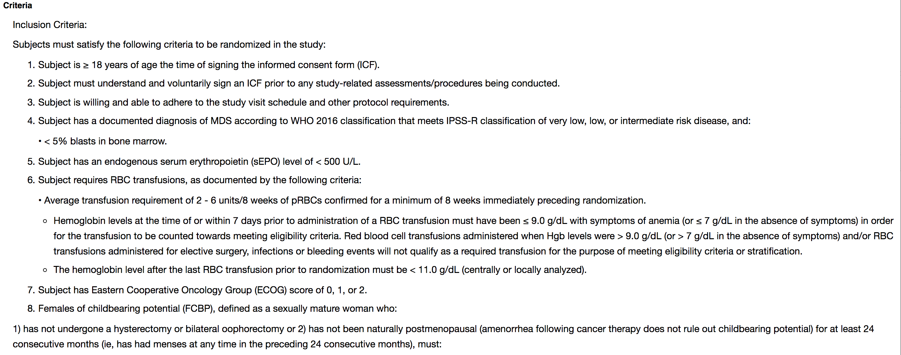
Eligibility Criteria is complex

Slide 5
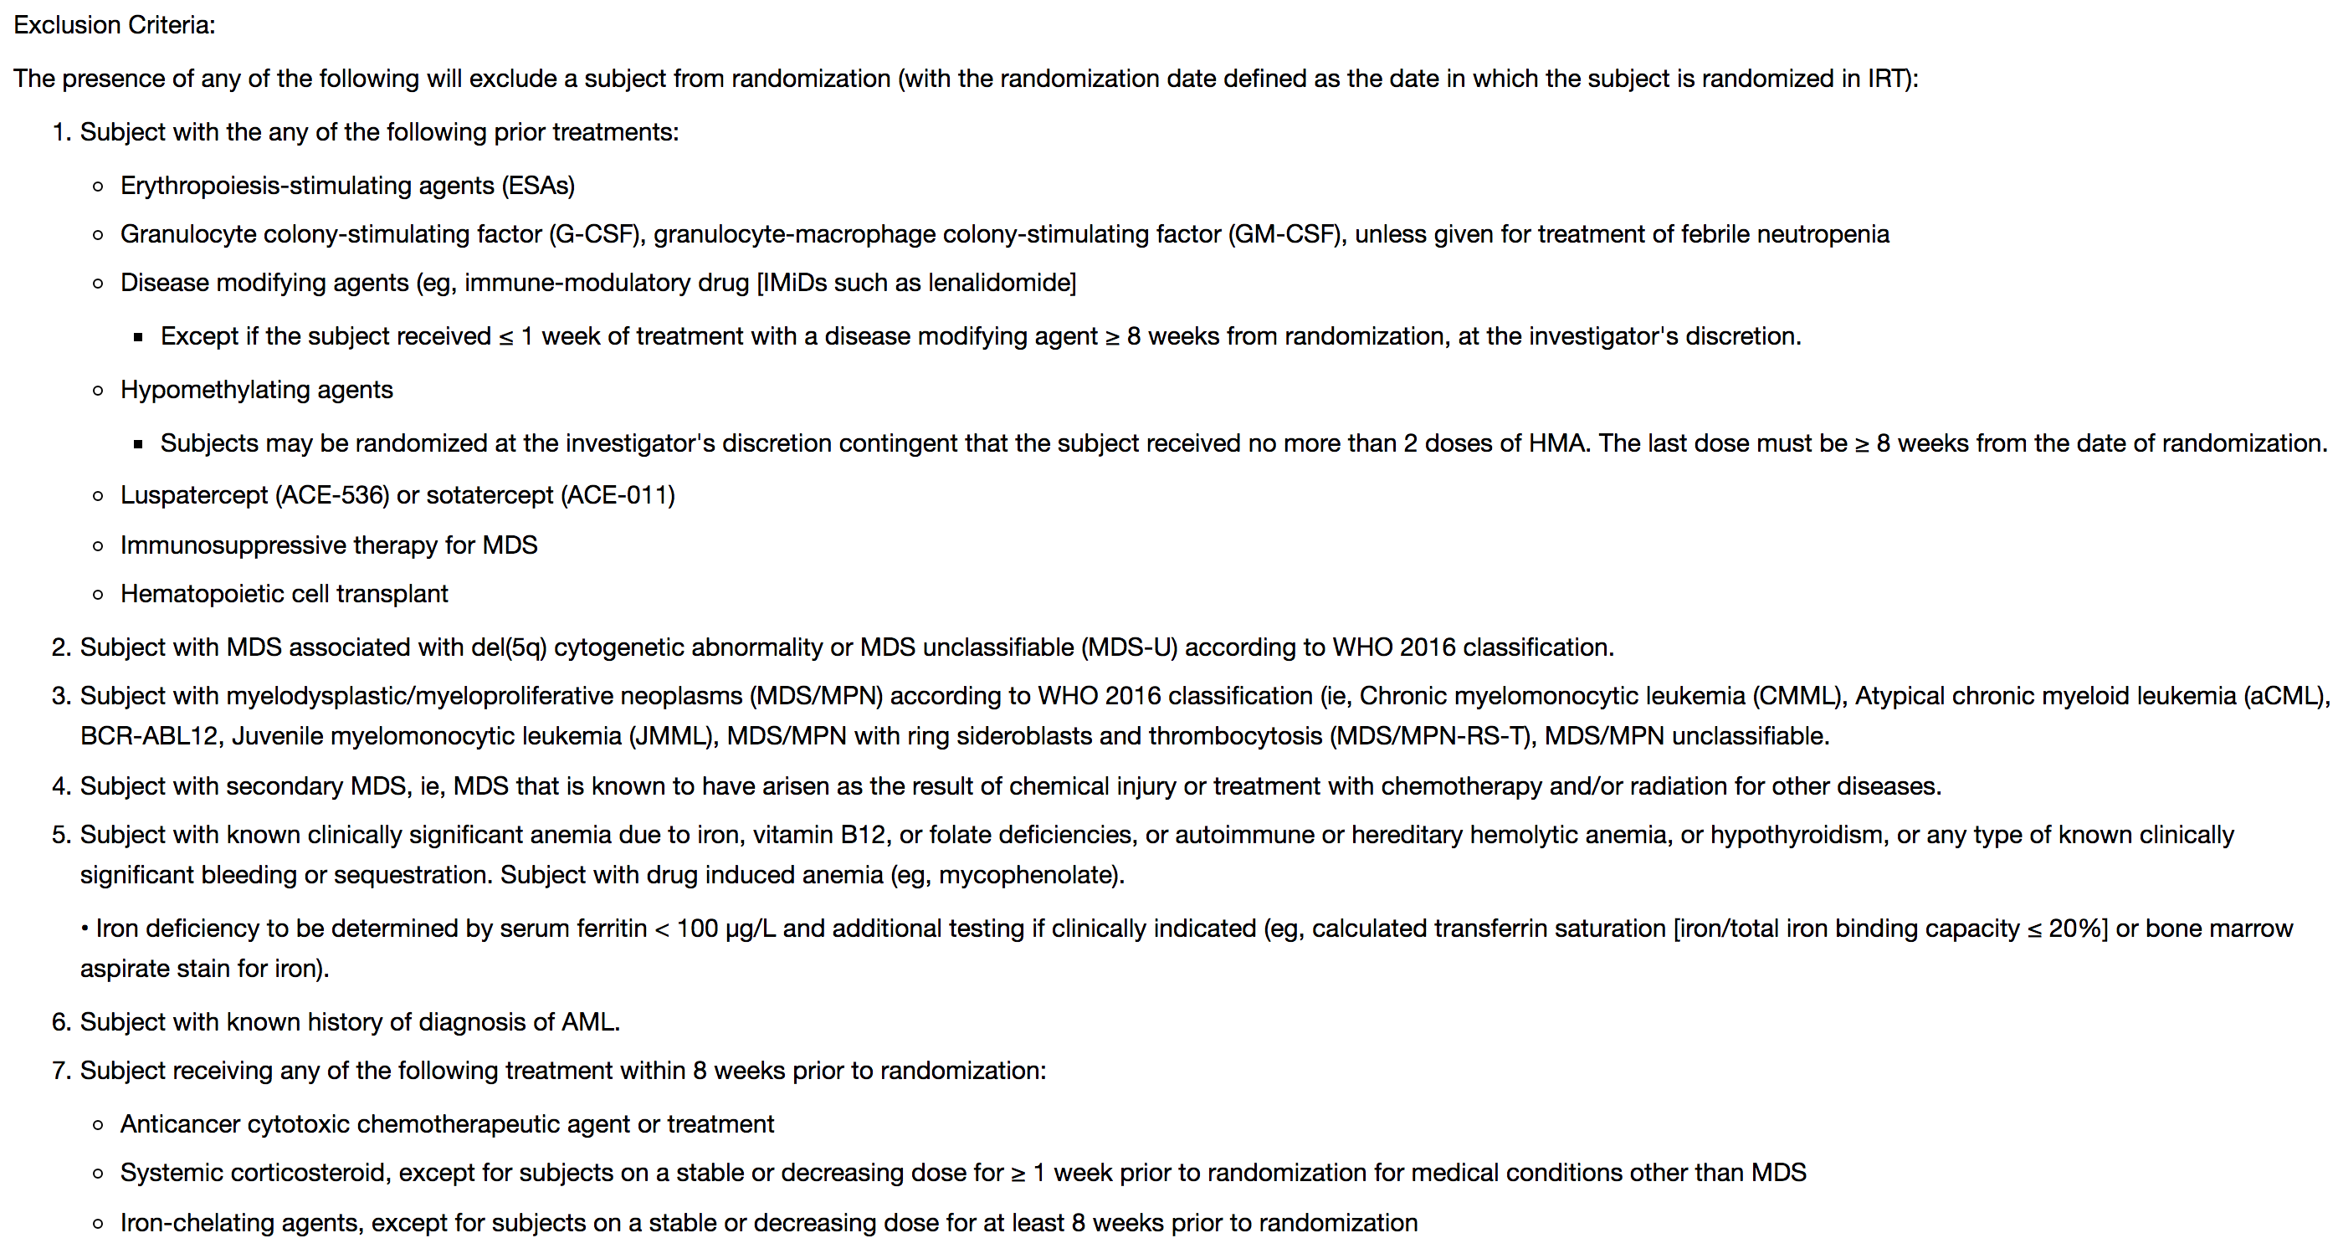
Exclusion Criteria as well

Slide 6
How are patients found?
A major academic / research center joins the project
Patients of relevant physician researchers are screened manually (typically by research nurses) to see if they may fit a trial
Some sites have data analysts that search the population for ICD, CPT, etc. codes for baseline criteria then hand off the result set for manual review

Slide 7
This is a very inefficient process.

Slide 8
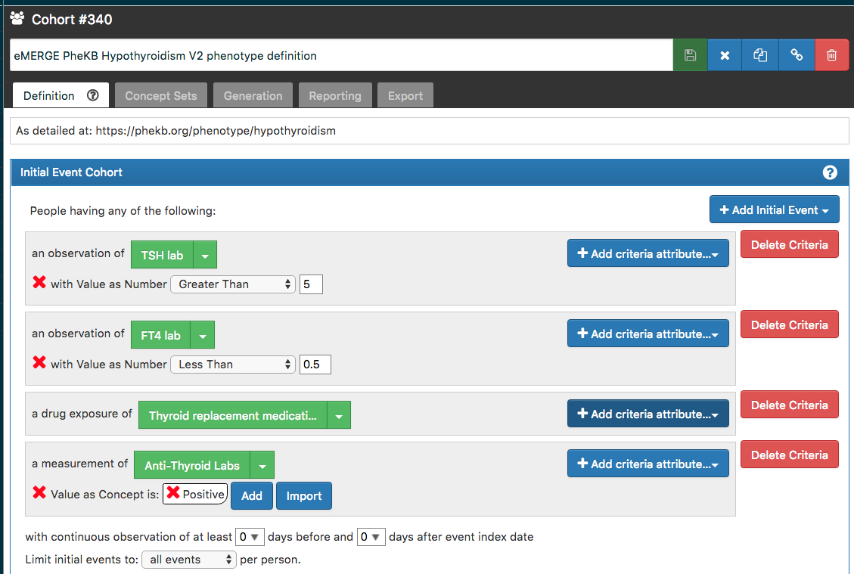
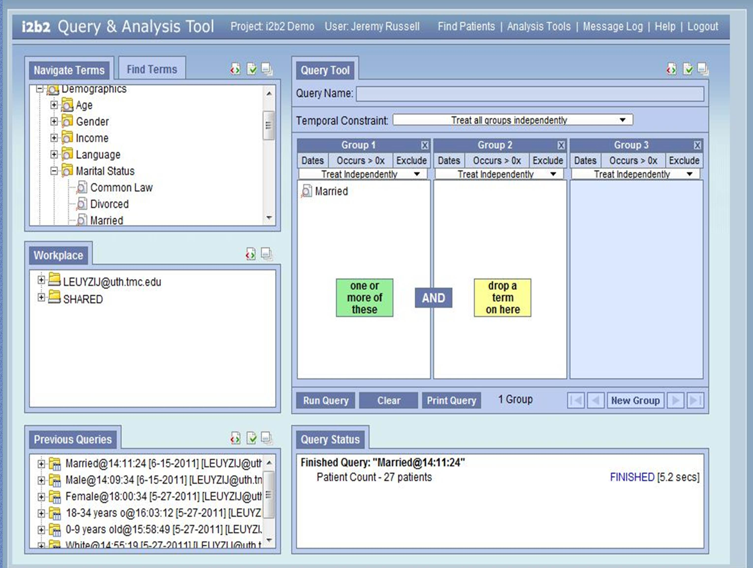
Advances are Being Made
Population-level screening has been improved through the use of standards like the OMOP Common Data Model (OHDSI) and i2b2

Slide 9
Structured vs. Unstructured Data
Structured data
Codes (e.g. diagnosis, procedures)
Lab value
Demographics
etc.
Unstructured data
Free text notes
Radiology reports
Pathology reports
etc.

Slide 10
ClarityNLP
Open source NLP platform developed at Georgia Tech Research Institute
Domain expert-friendly query syntax
Extensibility for developers to add their own NLP algorithms
Simplified ingestion and mapping to support cross-site queries
Built-in validation framework

Slide 11
ClarityNLP

Slide 12
Example Study
NCT03320486
The main purpose of this study is to demonstrate that dapaconazole cream 2% (experimental drug) is non-inferior to ketoconazole cream 2% (Nizoral® - active comparator) for the treatment of dermatological lesions of Tinea pedis.

Slide 13
Inclusion Criteria
Participants aged from 18 to 65 years old, male, or female with no childbearing potential or who are using an effective contraceptive method. - Structured
Presence of dermatological lesion(s) of Tinea pedis, with a global clinical severity score ≥ 4, being a minimum score of 2 for itching or desquamation/maceration and a minimum score of 2 for erythema. - Unstructured
No previous treatment with antimycotic medication, in the last 2 months, for the current dermatologic lesion. Structured
No evidence of other significant diseases, that, at the investigator's discretion, may affect the participation in the clinical trial, in accordance with the protocol requirements. Structured

Slide 14
Exclusion Criteria
Existing hepatic and/or renal diseases or other pathologic findings, which might interfere with the safety and tolerability of the active ingredients. Structured and Unstructured
Screening laboratory tests presenting deviations deemed as clinically significant, which, due to possible risks, prevents the participation in clinical trial. Structured
Known hypersensitivity to ketoconazole or to chemically related compounds (azoles) or to the compounds of the investigational products. Unstructured
Positive anti human immunodeficiency virus (anti-HIV) test, positive Hepatitis B Surface Antigen (HBs-Ag) test or positive anti hepatitis C virus (anti-HCV) test. Structured
Treatment, within 3 months prior to the start of the clinical trial treatment, with any drug known to have a well-established toxic potential to major organs. Structured
Pregnant or lactating women Structured and Unstructured
Presence of "Moccasin type" Tinea pedis Unstructured
History of drug addiction Unstructured

Slide 15
Example: History of drug addiction
Finding this manually by reviewing throughout the chart is time consuming
ClarityNLP can be used to identify such features rapidly:

Slide 16
Example: Drug addiction

Slide 17
Another Example Study
NCT01569178
This is a multinational, multicentre, randomised open-label, controlled, parallel-group phase III study. Its aim is to demonstrate that a single intracoronary infusion of autologous bone marrow-derived mononuclear cells is safe and reduces all-cause mortality in patients with reduced left ventricular ejection fraction(</=45%) after successful reperfusion for acute myocardial infarction when compared to a control group of patients undergoing best medical care.

Slide 18
Inclusion Criteria
Men and women of any ethnic origin aged≥18years Structured
Patients with acute ST-elevation myocardial infarction as defined by the universal definition of AMI. Structured and Unstructured
Successful acute reperfusion therapy (residual stenosis visually <50% and TIMI flow ≥2) within 24 hours of symptom onset Unstructured
Left ventricular ejection fraction ≤ 45% with significant regional wall motion abnormality Unstructured
Open coronary artery suitable for cell infusion supplying the target area of abnormal wall motion Unstructured

Slide 19
Exclusion Criteria
Previously received stem/progenitor cell therapy Unstructured
Pregnant or nursing women Structured and Unstructured
Cardiogenic shock requiring mechanical support Structured and Unstructured
Platelet count <100.000/µl, or hemoglobin <8.5 g/dl Structured
Impaired renal function, i.e. creatinine >2.5 mg/dl Structured
Fever or diarrhoea not responsive to treatment within 4 weeks prior screening Structured and Unstructured
Clinically significant bleeding disorder within 3 months prior screening Structured
Uncontrolled hypertension (systolic >180 mmHg and diastolic >120 mmHg) Structured

Slide 20
Left ventricular ejection fraction ≤ 45% with significant regional wall motion abnormality
Going through chart to find is time consuming
ClarityNLP can be used to identify patients rapidly:

Slide 21
Low EF Patients

Slide 22
ClarityNLP on FHIR
Currently, we can retrieve clinical documents and process for unstructured criteria

Slide 23
Goal
Need to develop an application that uses FHIR to retrieve both structured and unstructured criteria
Structured criteria to be expressed using CQL (clinical query language)
Allows specification of codes, labs, and other values using and expressive language
Unstructured criteria would be expressed using NLPQL

Slide 24
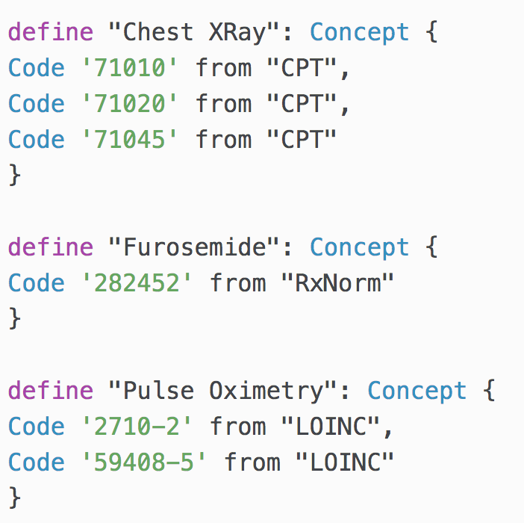
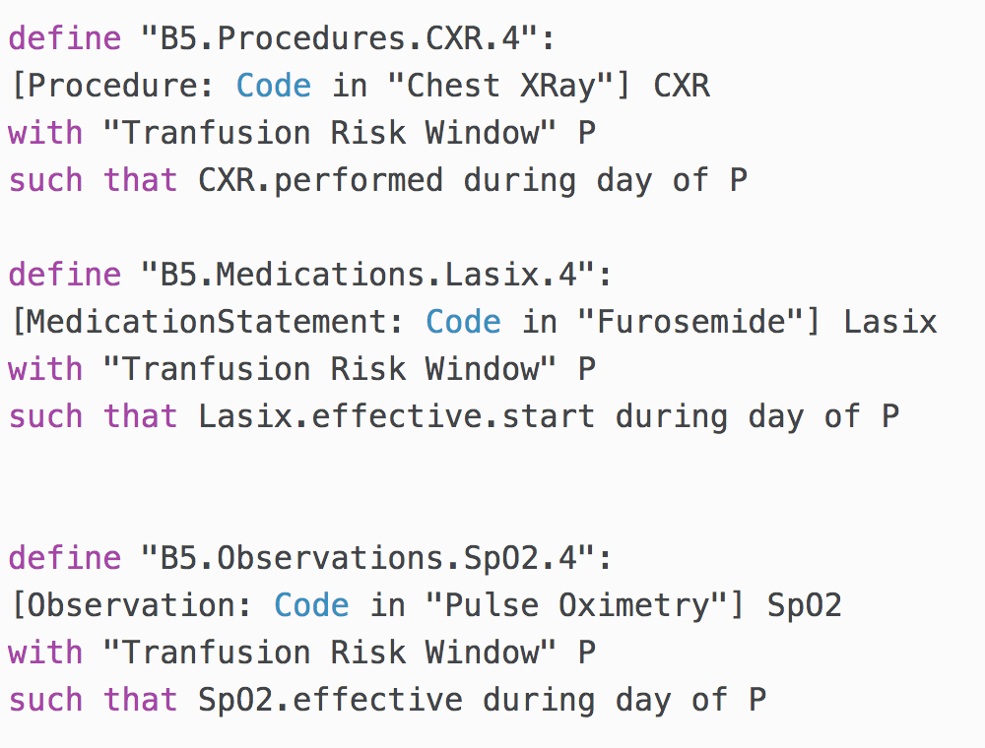
CQL Example

Slide 25
CQL FHIR Engine Processes CQL to FHIR Query

Slide 26
Pilot Project #1
Create an app that utilizes CQL+FHIR and ClarityNLP+FHIR to:
Specify a patient id
Specify a study (any study)
Run CQL / NLPQL (developed by ClarityNLP team)
Display all matching patient information as well as failed criteria

Slide 27
Pilot Project #2
Create an app that utilizes ClarityNLP NLPQL+FHIR to:
Specify a patient id
Specify a study (any study)
Run NLPQL on patient documents
Display results and inclusion/exclusion matches (improve on existing ClarityNLP FHIR client)
Integrate with Cerner or HSPC Sandbox

Slide 28
Seeking Two Teams
Seeking to test with two different clinical trial types as well as develop alternate interface designs
Teams should include students with:
Human factors experience
Back-end API development
Front-end development (React preferred)
NLP experience (bonus)

